Slide 1
Visualization, Deep Dream, Neural Style, Adversarial Examples
엮은이 : 김동화

Slide 2
Contents
Introduction
How to project the feature activations back to the input pixel space
Visualizing and understanding CNN
How can we find an image that maximizes some class score
Visualizing via Regularized optimization
Deep dream
Neural Style
Adversarial Examples

Slide 3
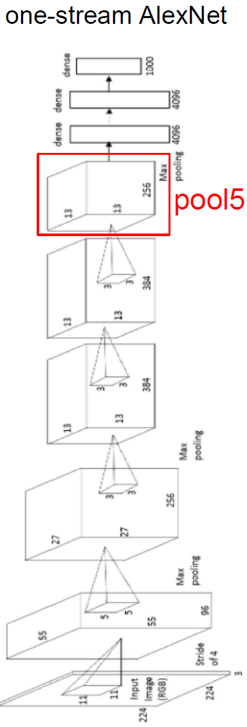
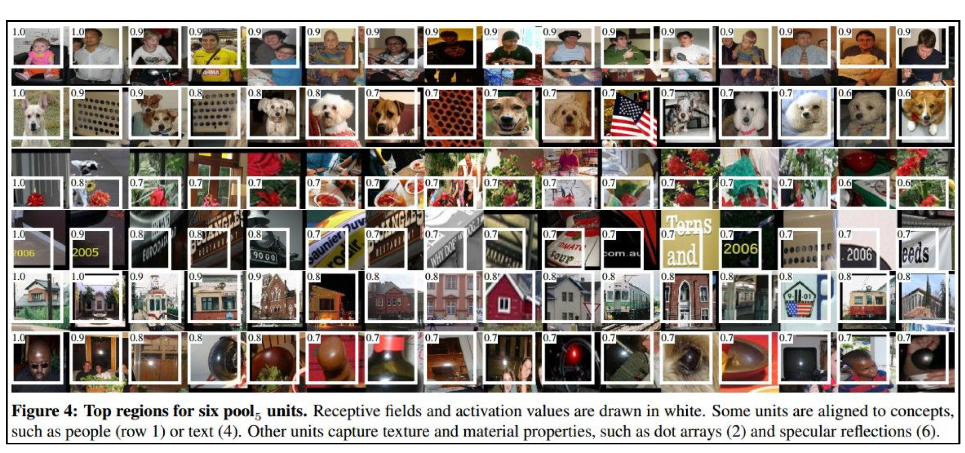
Introduction
Raw activation of conv net
가장 쉽게 직관적으로 이해 할 수 있음
뭐가 어떻게 되가는지 해석적으로 알기 어려움

Slide 4
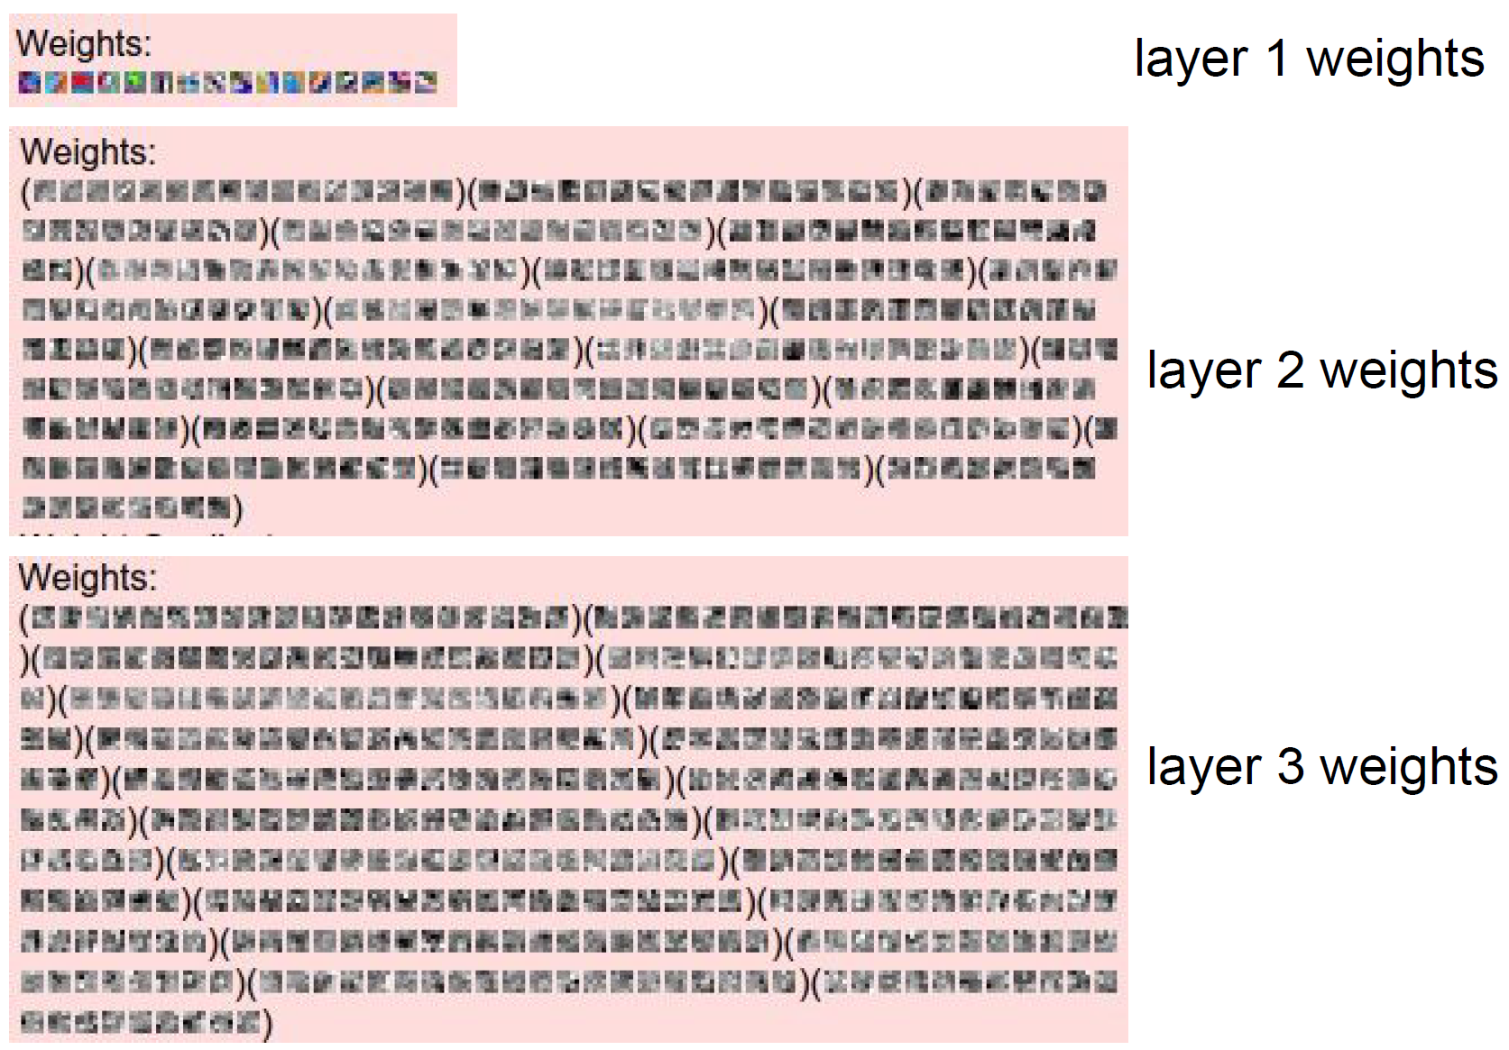
Introduction
Raw filter Weights
본 이미지와 연결되어 있는 첫번째 레이어만 설명가능

Slide 5
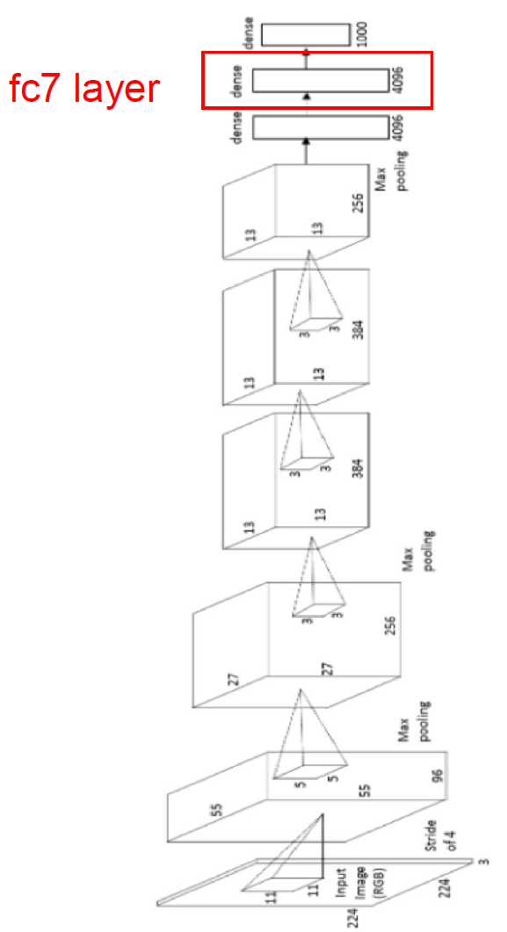
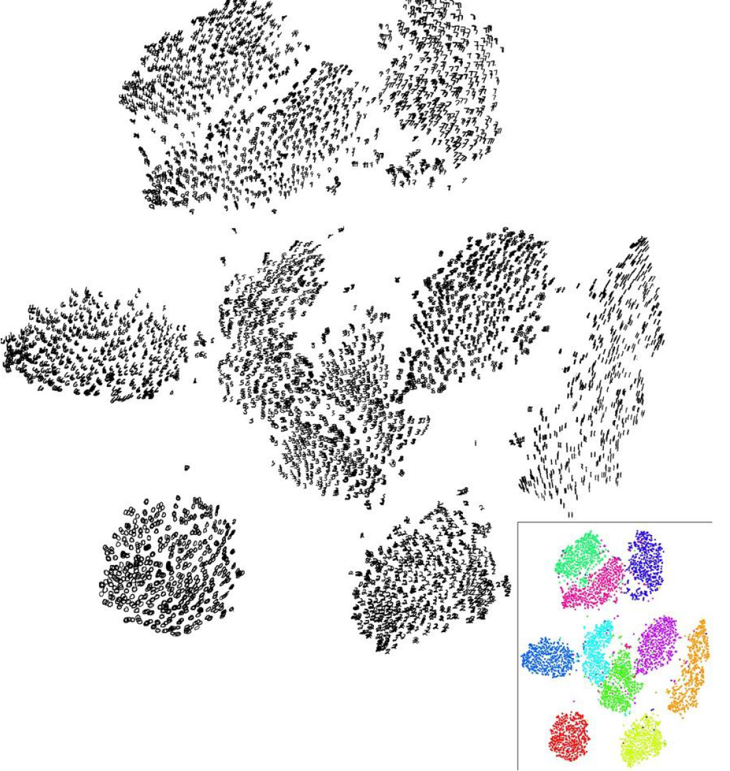
Introduction
The global representation
MNIST digits
t-SNE
similar things
end up in similar places

Slide 6
Contents
Introduction
How to project the feature activations back to the input pixel space
Visualizing and understanding CNN
How can we find an image that maximizes some class score
Visualizing via Regularized optimization
Deep dream
Neural Style
Adversarial Examples

Slide 7
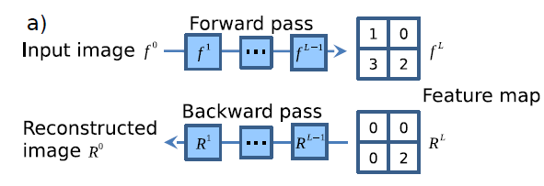
Schematic of visualizing the activations of high layer neurons
Reconstructed image
우리가 알고자하는 특정 한 뉴런(gradient =1 or 활성함수 값)을 제외한 후 모든 그래디언트를 0으로 설정

Slide 8
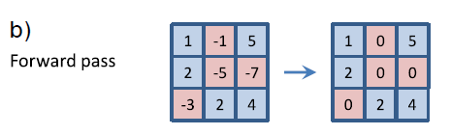
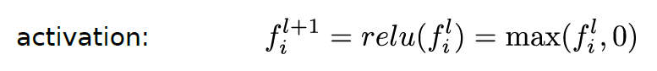
Schematic of visualizing the activations of high layer neurons
Forward pass

Slide 9
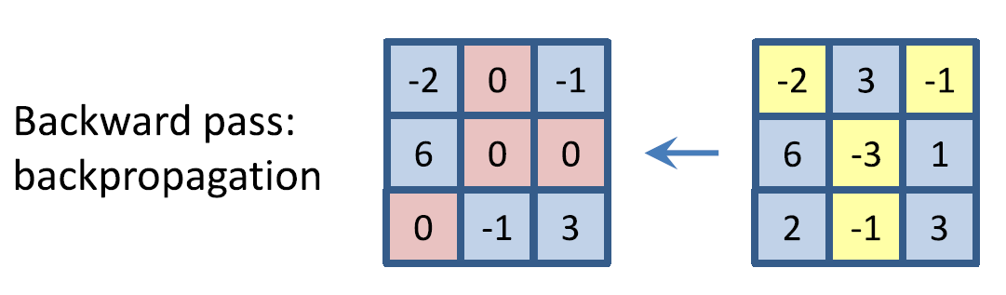
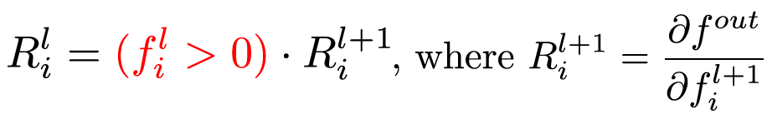
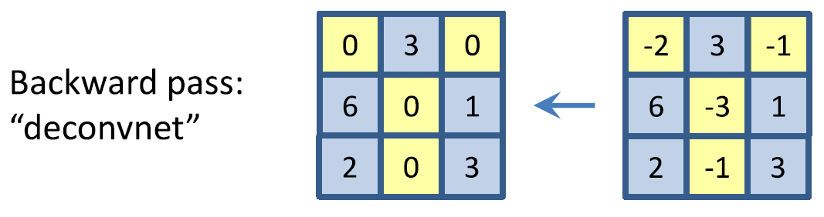
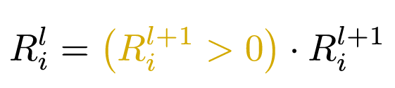
Schematic of visualizing the activations of high layer neurons
Backward pass
Back propagation(Bottom data에 대응)
Deconvnet(Top gradient에 대응)
Max pooling, Switch location map을 통한 reconstruct
Notes:
주어진 뉴런을 엑티베이션을 백워드 패스에 사용한다

Slide 10
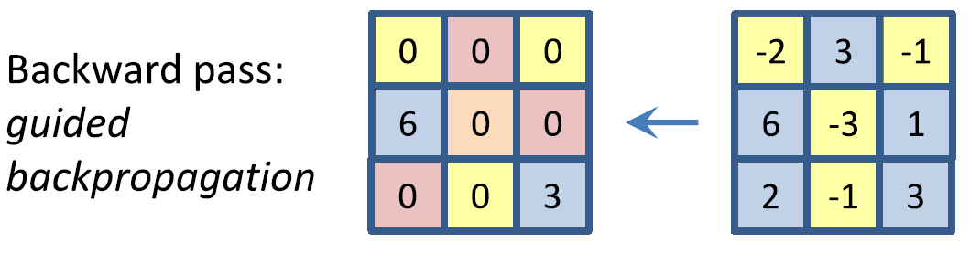
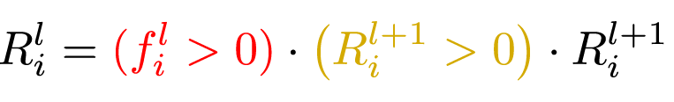
Schematic of visualizing the activations of high layer neurons
Backward pass
3. Guided backpropagation
A combined method from Back propagation and Deconvnet
Max pooling, Switch location map을 사용하지 않음
모든 음의 activation 값을 0으로 바꿈: 더 명확한 이미지로 reconstruct
Modification of the deconv net : 특히 높은 레이어에서 더 정확한 성능을 보임

Slide 11
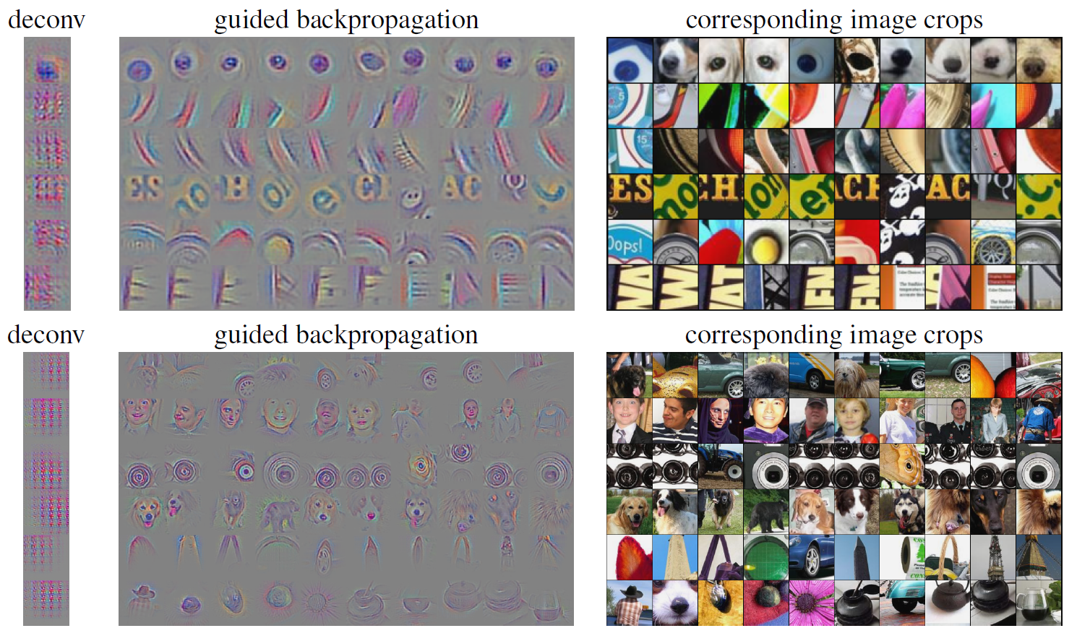
Schematic of visualizing the activations of high layer neurons
Example1
Conv 6
Conv 9
Notes:
이미지넷
각 행은 하나의 필터에 대응
가이드 백프로러 Top 10
Pooling 을 사용하지 않은듯

Slide 12
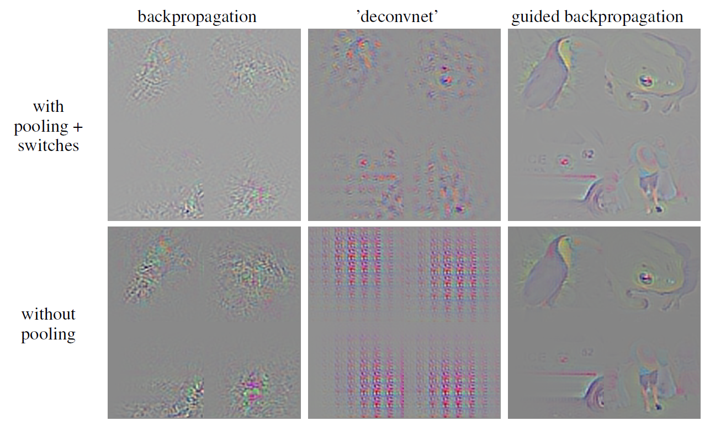
Schematic of visualizing the activations of high layer neurons
Example 2
Notes:
이미지넷
각 행은 하나의 필터에 대응
가이드 백프로러 Top 10

Slide 13
Contents
Introduction
How to project the feature activations back to the input pixel space
Visualizing and understanding CNN
How can we find an image that maximizes some class score
Visualizing via Regularized optimization
Deep dream
Neural Style
Adversarial Examples

Slide 14
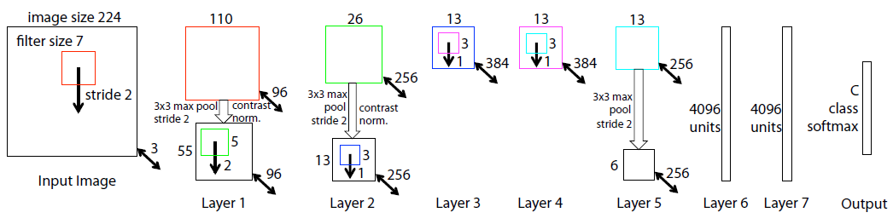
Visualizing and understanding CNN
Visualizing and Understanding Convolutional Networks, Matthew D. Zeiler
Architecture of the 8 layer convnet model
Notes:
9216

Slide 15
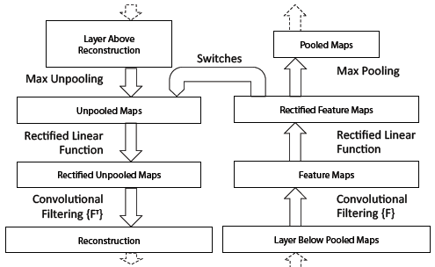
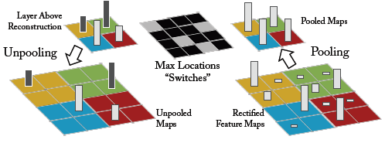
Visualizing and understanding CNN
Visualizing and Understanding Convolutional Networks, Matthew D. Zeiler
Deconvnet : to project the feature activations back to the input pixel space
Notes:
활성화된 필터를 사용

Slide 16
Visualizing and understanding CNN
Visualizing and Understanding Convolutional Networks, Matthew D. Zeiler
Deconvnet : to project the feature activations back to the input pixel space

Slide 17
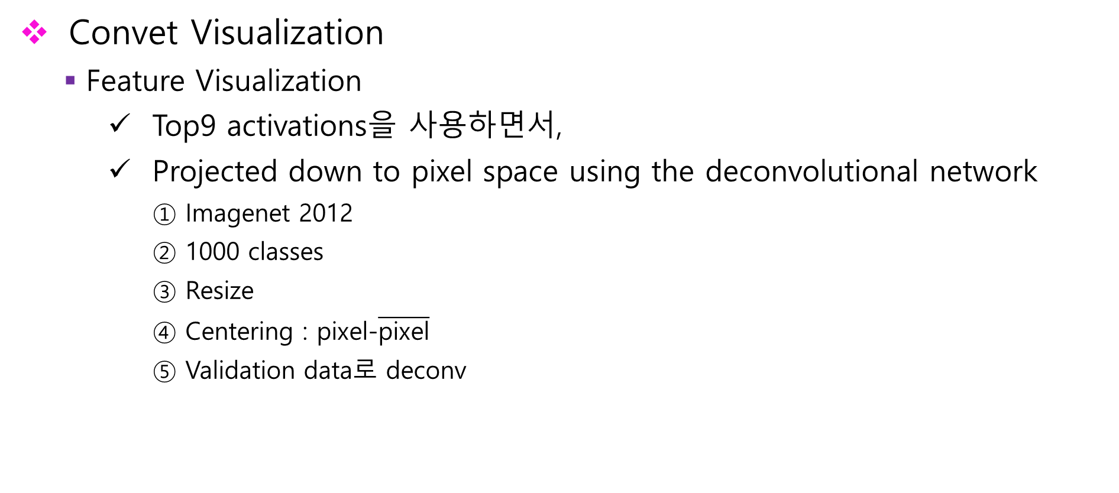
Visualizing and understanding CNN
Visualizing and Understanding Convolutional Networks, Matthew D. Zeiler
Convet Visualization
Feature Visualization
Top9 activations을 사용하면서,
Projected down to pixel space using the deconvolutional network
Imagenet 2012
1000 classes
Resize
Centering : pixel-$\overline{\text{pixel}}$
Validation data로 deconv

Slide 18
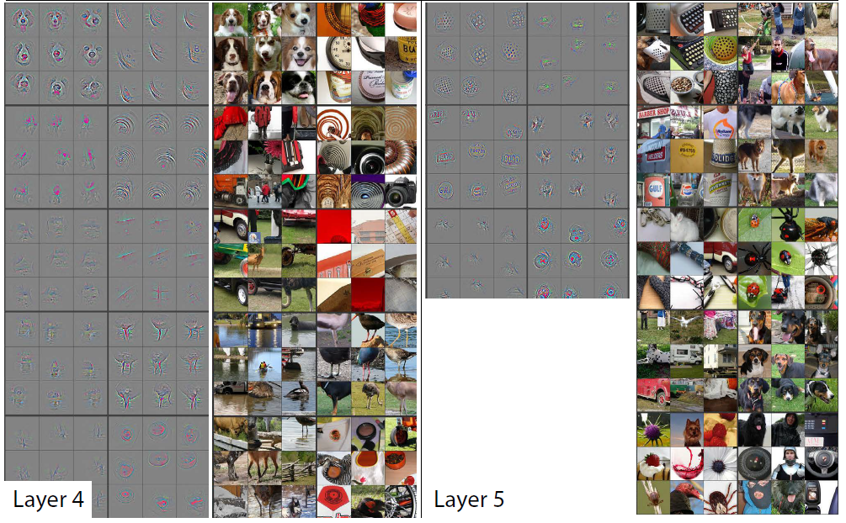
Visualizing and understanding CNN
Visualizing and Understanding Convolutional Networks, Matthew D. Zeiler
The features that have strong grouping from the top 9 activations
It might focus on the background, not the foreground.
Notes:
패치단위로 시각화시켜논건데
각 패치간의 판별구조에 대해서 시각화하는 방식보다

Slide 19
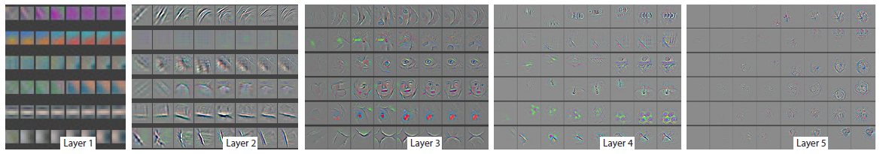
Visualizing and understanding CNN
Visualizing and Understanding Convolutional Networks, Matthew D. Zeiler
Feature Evolution during Training
보다 정교한 이미지를 표현하기 위해서 높은 epoch가 필요

Slide 20
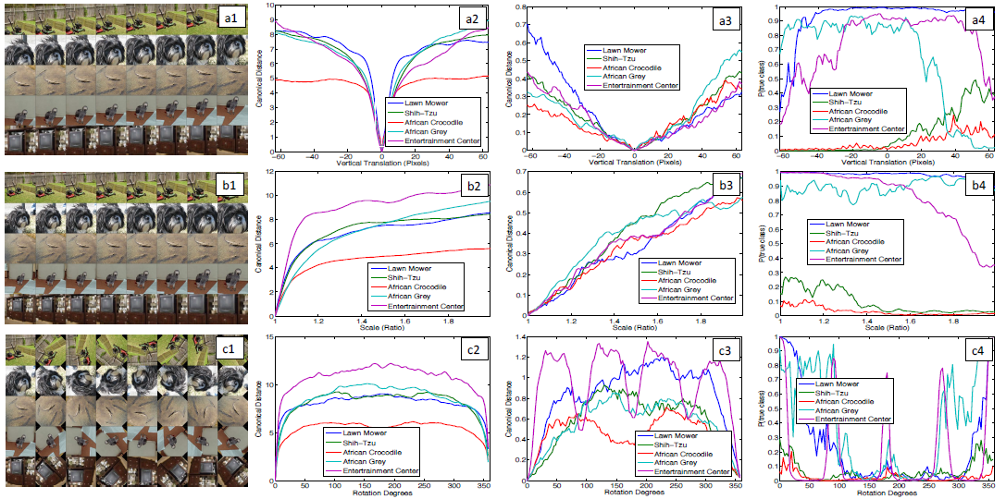
Visualizing and understanding CNN
Visualizing and Understanding Convolutional Networks, Matthew D. Zeiler
Feature Invariance
이미지를 rotation, scale, vertical translation을 한 후 유사도 거리 측정

Slide 21
Visualizing and understanding CNN
Visualizing and Understanding Convolutional Networks, Matthew D. Zeiler
Feature Invariance
이미지를 rotation, scale, vertical translation을 한 후 유사도 거리 측정
Layer 1
feature
Layer 7
feature
P(true class)

Slide 22
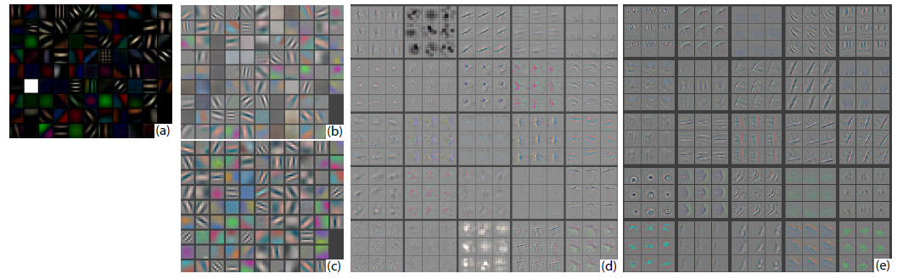
Visualizing and understanding CNN
Visualizing and Understanding Convolutional Networks, Matthew D. Zeiler
Architecture Selection
1 layer: a mix of extremely high(a), low frequency information
2 layer: aliasing artifacts
Layer 1
Layer 2
No scale, clipping

Slide 23
Visualizing and understanding CNN
Visualizing and Understanding Convolutional Networks, Matthew D. Zeiler
Architecture Selection
1 layer: a mix of extremely high(a), low frequency information
2 layer: aliasing artifacts
The solution: the smaller stride and filter size
Layer 1
Layer 2
No scale, clipping

Slide 24
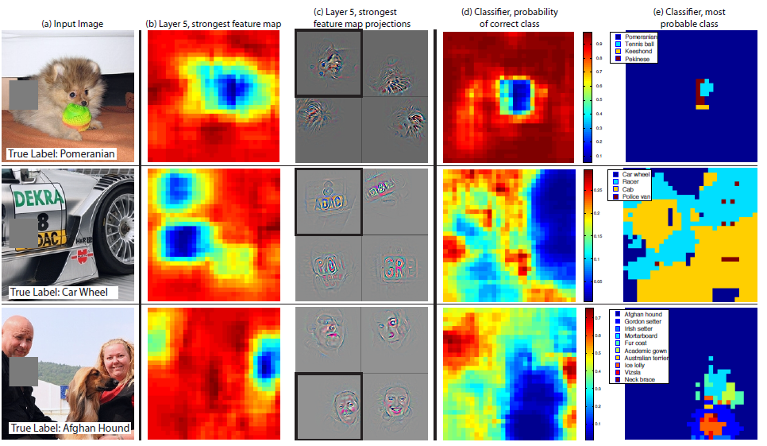
Visualizing and understanding CNN
Visualizing and Understanding Convolutional Networks, Matthew D. Zeiler
Occlusion sensitivity
학습된 모델이 실제로 객체의 위치를 식별할 수 있는가?
Gray square로 이미지를 가림
이 때 타켓 클래스의 확률이 얼마나 떨어지는지로 히트맵으로 시각화 할 수 있음

Slide 25
Visualizing and understanding CNN
Visualizing and Understanding Convolutional Networks, Matthew D. Zeiler
Occlusion sensitivity
학습된 모델이 실제로 객체의 위치를 식별할 수 있는가?
Gray square로 이미지를 가림
이 때 타켓 클래스의 확률이 얼마나 떨어지는지로 히트맵으로 시각화 할 수 있음
Feature map
Class probability
Notes:
Layer 5
Unoccluded image를 학습
다중공선성
테니스공을 인식시킬수 있음
얼굴인식 피쳐가 되버림

Slide 26
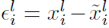
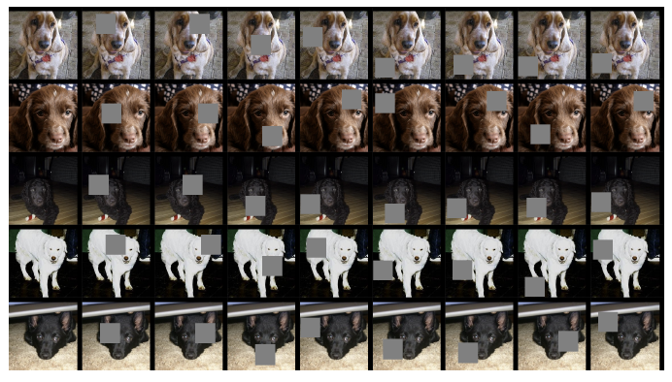
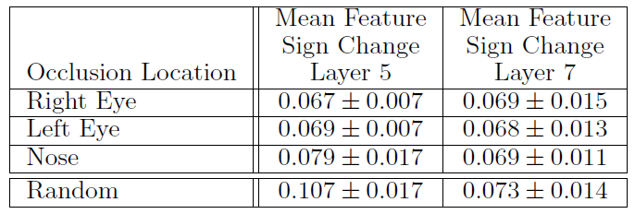
Visualizing and understanding CNN
Visualizing and Understanding Convolutional Networks, Matthew D. Zeiler
Correspondence analysis
다른 이미지들(개 그림)에서 특정 Object part(눈,코)들이 잘 대응을 하는가를 알아보는 분석
,

Slide 27
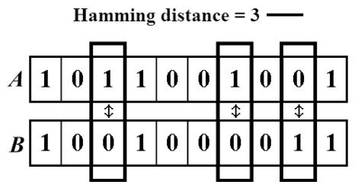
Visualizing and understanding CNN
Visualizing and Understanding Convolutional Networks, Matthew D. Zeiler
Correspondence analysis
다른 이미지들(개 그림)에서 특정 Object part(눈,코)들이 잘 대응을 하는가를 알아보는 분석
,
원래 이미지 벡터
특정 부분을
가린 이미지 벡터
$ε$ 의일관성을 측정하고 싶음 => Hamming distance

Slide 28
Contents
Introduction
How to project the feature activations back to the input pixel space
Visualizing and understanding CNN
How can we find an image that maximizes some class score
Visualizing via Regularized optimization
Deep dream
Neural Style
Adversarial Examples

Slide 29
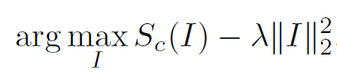
Visualizing focused on the classes with saliency
Deep Inside Convolutional Networks: Visualising Image Classification Models and Saliency Maps, Karen Simonyan
Maximizes some class score
전체 파라미터들을 고정시킨 후 임의적으로 스코어(class)를 최대화시키고자 함(with Regularization)
학습과정에서 weight고정시키고, input image에 관해 최적화가 수행 됨
Zero image로 초기화(=zero-centered image data)
Zero image 관심있는 스코어를 제와한 부분들을 0으로 바꿈
Backward pass에서 무엇이 바뀌었는가 확인, 그리고 이미지(score) 업데이트
Class Score from image
L2 Regularization
Notes:
사후확률은 목적식이아님 스코어가 직접적으로 픽셀로 표현되어져야 함

Slide 30
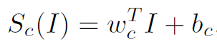
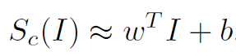
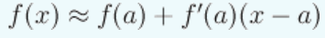
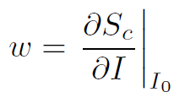
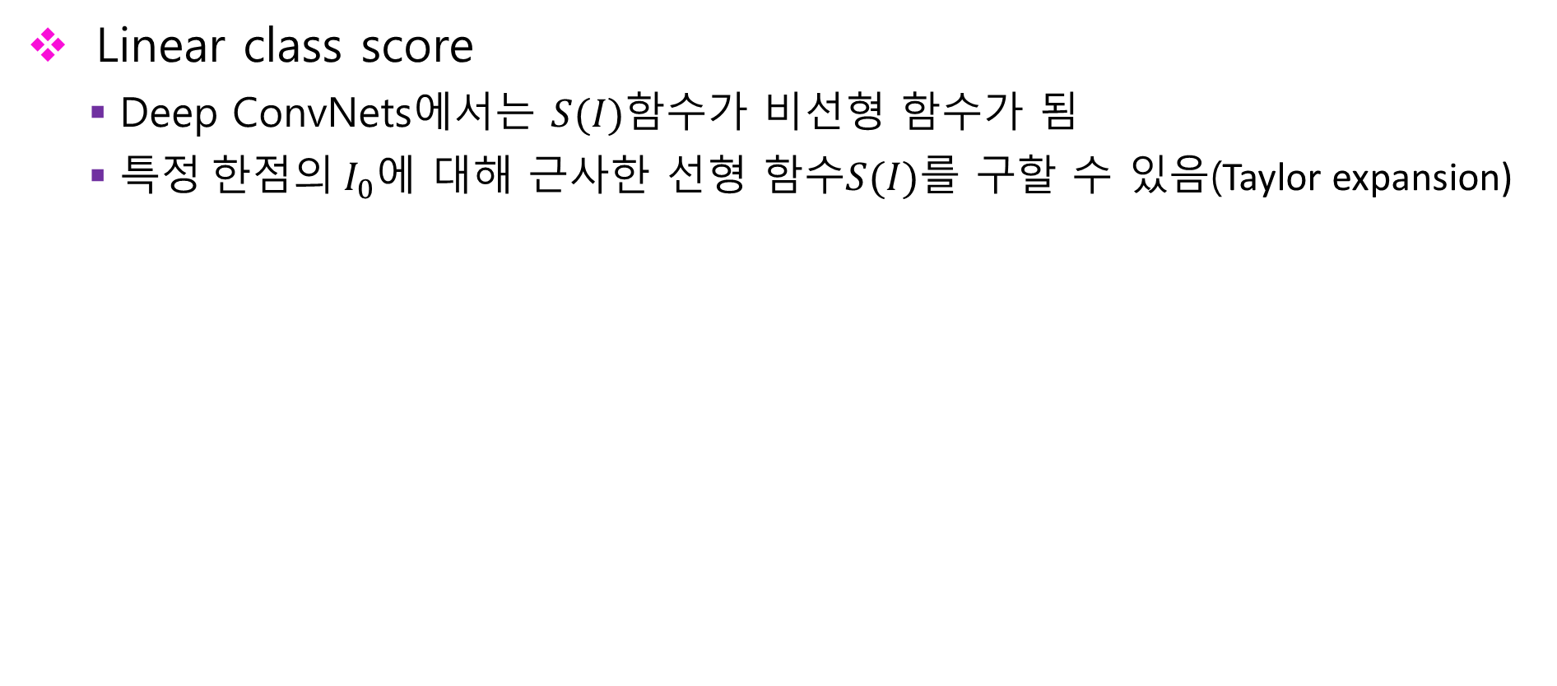
Visualizing focused on the classes with saliency
Deep Inside Convolutional Networks: Visualising Image Classification Models and Saliency Maps, Karen Simonyan
Linear class score
Deep ConvNets에서는 $S(I)$함수가 비선형 함수가 됨
특$정 한점의 I_{0}$에 대해 근사한 선형 함수$S(I)$를 구할 수 있음(Taylor expansion)
First-order Taylor expansion
Notes:
w is equal to the number of pixels in I0

Slide 31
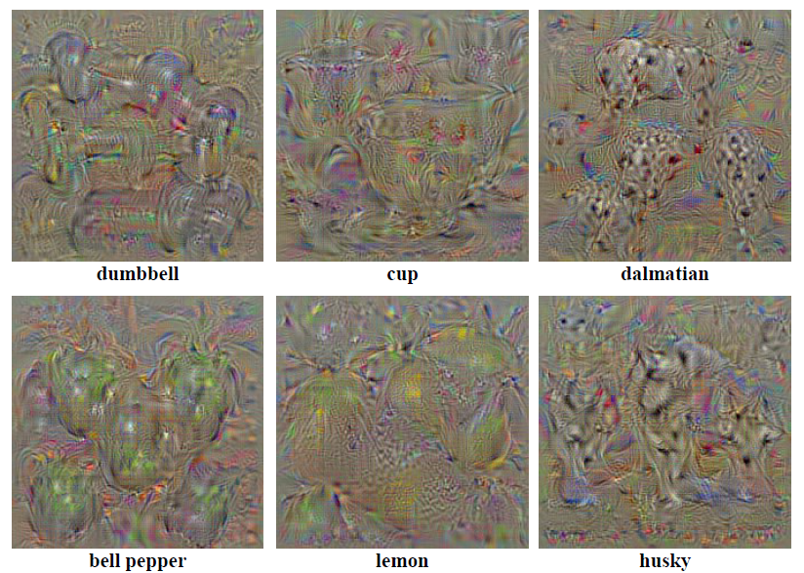
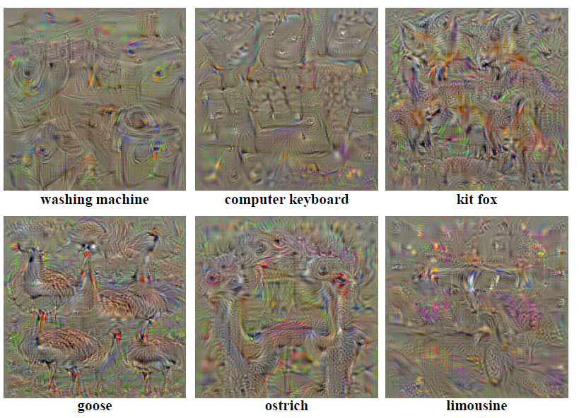
Visualizing focused on the classes with saliency
Deep Inside Convolutional Networks: Visualising Image Classification Models and Saliency Maps, Karen Simonyan
The results of focusing on the classes
Gradient signal 로 형성된 이미지
Notes:
주름 같은 의미없는 것들은 클래스로 고려되지 않으므로 특별한 형성체가 없고
특정 개체(클래스)가 간섭하게 되면 스코어 변화하고 (단일 픽셀들에 대해서 ) 다음과 같은 객체의 형상이 표현됨

Slide 32
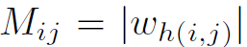
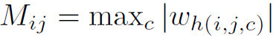
Visualizing focused on the classes with saliency
Deep Inside Convolutional Networks: Visualising Image Classification Models and Saliency Maps, Karen Simonyan
Class Saliency Extraction
픽셀마다 w 값이 존재
M: saliency feature map
# grey scale
# multi scale (RGB)

Slide 33
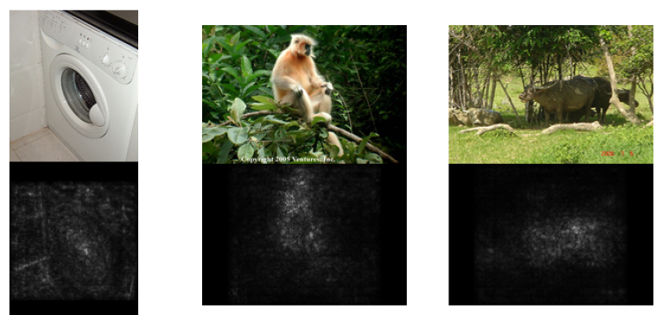
Visualizing focused on the classes with saliency
Deep Inside Convolutional Networks: Visualising Image Classification Models and Saliency Maps, Karen Simonyan
동일 이미지를 조금씩 수정한10개 (cropped, reflected) sub-images를 평균한 saliency maps

Slide 34
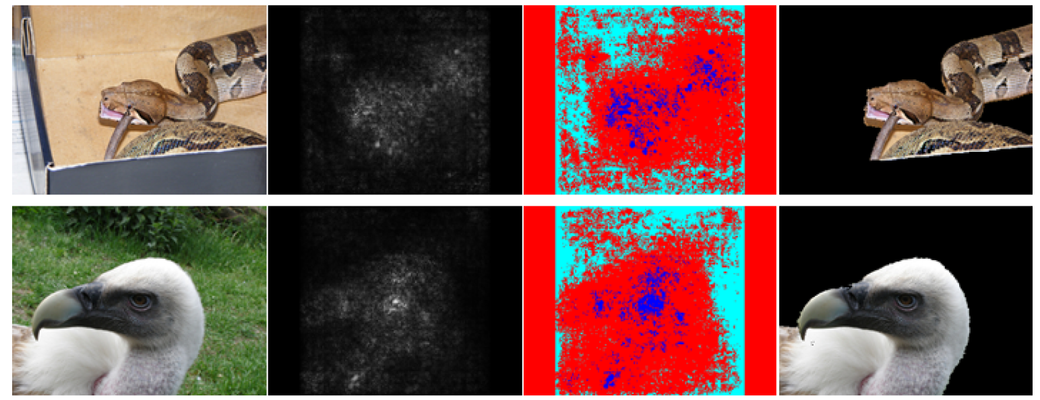
Visualizing focused on the classes with saliency
Deep Inside Convolutional Networks: Visualising Image Classification Models and Saliency Maps, Karen Simonyan
Pros and cons
No additional annotation is required (Object bounding boxes, or segmentation masks)
The computation is very quick , but it is hard to make the significant performance

Slide 35
Visualizing focused on the classes with saliency
Deep Inside Convolutional Networks: Visualising Image Classification Models and Saliency Maps, Karen Simonyan
Pros and cons
No additional annotation is required (Object bounding boxes, or segmentation masks)
The computation is very quick , but it is hard to make the significant performance
Gaussian mixed model [foreground(95%) + background(30%)]

Slide 36
Contents
Introduction
How to project the feature activations back to the input pixel space
Visualizing and understanding CNN
How can we find an image that maximizes some class score
Visualizing via Regularized optimization
Deep dream
Neural Style
Adversarial Examples

Slide 37
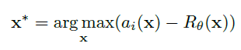
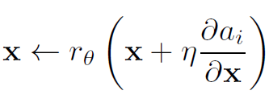
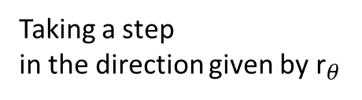

Visualizing via Regularized optimization
Understanding Neural Networks Through Deep Visualization, Jason Yosinski
Regularized optimization
Objective function
Gradient framework
activations
Regularization given $θ$
4가지 방식
Taking a step
in the direction given by ${\text{r}}_{θ}$
gradient
descent step size

Slide 38
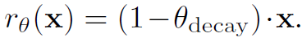
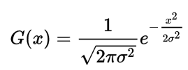
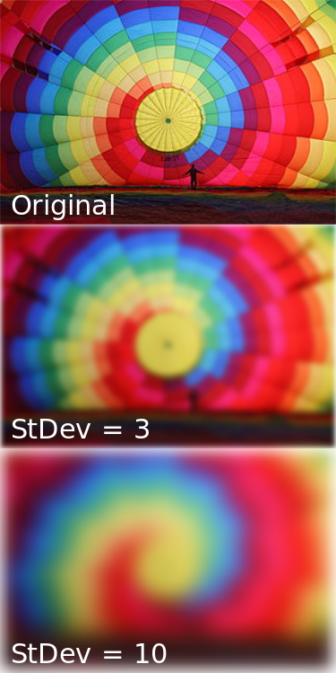
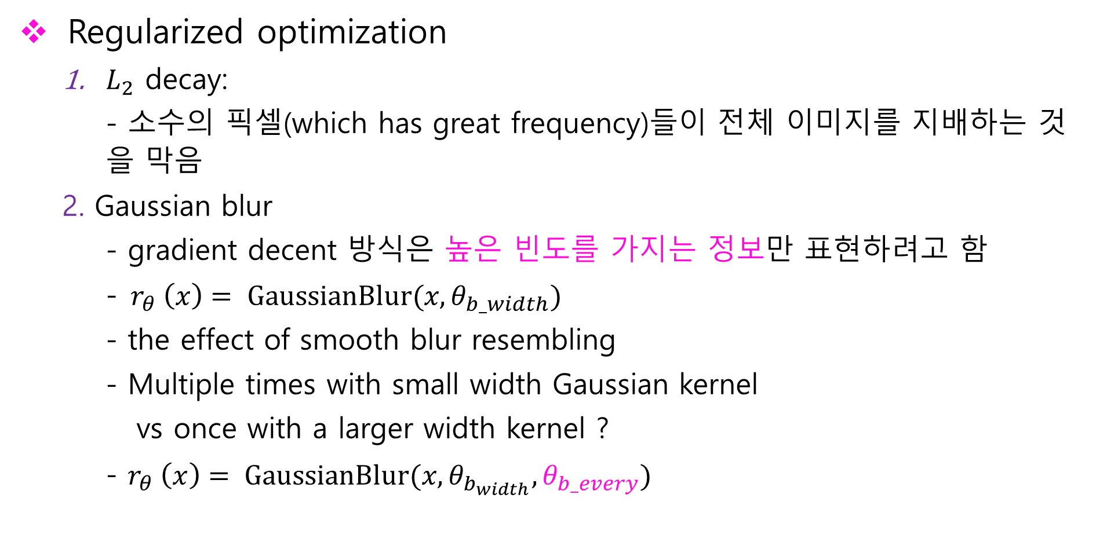
Visualizing via Regularized optimization
Understanding Neural Networks Through Deep Visualization, Jason Yosinski
Regularized optimization
$L_{2}$ decay:
- 소수의 픽셀(which has great frequency)들이 전체 이미지를 지배하는 것 을 막음
2. Gaussian blur
- gradient decent 방식은 높은 빈도를 가지는 정보만 표현하려고 함
-${ r}_{θ} \left(x\right)= GaussianBlur(x, θ_{b_width})$
- the effect of smooth blur resembling
- Multiple times with small width Gaussian kernel
vs once with a larger width kernel ?
- $r_{θ} \left(x\right)= GaussianBlur(x, θ_{b_{width}},θ_{b_every})$
Notes:
높은빈도를 가지는 활성함수를 가질수있지만 해석적이지 않을수 있음
Blur_width
커널 필터, 함수에 각 픽셀정보가 변형됨

Slide 39
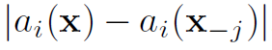
Visualizing via Regularized optimization
Understanding Neural Networks Through Deep Visualization, Jason Yosinski
Regularized optimization
3. Clipping pixels with small norm
- Small activation which has some pattern is going to be amplified
- It dose not matter to make the regions be zero if they are not needed
- if(the norm of each pixel over RGB< threshold (=a percentile of all pixel norms) ) = 0
4. Clipping pixels with small contribution
- pixel’s contribution = how much the activations is going up or down from 0
For all the pixel
The activation value
The activation value provide that jth pixel is zero

Slide 40
Visualizing via Regularized optimization
Understanding Neural Networks Through Deep Visualization, Jason Yosinski
Regularized optimization
3. Clipping pixels with small norm
- Small activation which has some pattern is going to be amplified
- It dose not matter to make the regions be zero if they are not needed
- if(the norm of each pixel over RGB< threshold (=a percentile of all pixel norms) ) = 0
4. Clipping pixels with small contribution
- pixel’s contribution = how much the activations is going up or down from 0
For all the pixel
Too much slow..
The activation value
The activation value provide that jth pixel is zero

Slide 41
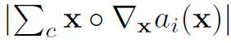
Visualizing via Regularized optimization
Understanding Neural Networks Through Deep Visualization, Jason Yosinski
4. Clipping pixels with small contribution
- Elementwise product of x and the gradient (sum over all 3 channels)
- Contribution in either direction, positive or negative
if( < threshold ) =0

Slide 42

Visualizing via Regularized optimization
Understanding Neural Networks Through Deep Visualization, Jason Yosinski
The effects of each regularization method
Notes:
노이즈 제거
가우시안 스면 낮은 활성함수값도 패턴을 구할 수 있음
잘라내기 놈,공헌도 컷을 높게 주면 다 0으로 보냄

Slide 43

Visualizing via Regularized optimization
Understanding Neural Networks Through Deep Visualization, Jason Yosinski
Conv layer feature from regularized images
4 random gradient descent runs for each channel

Slide 44

Visualizing via Regularized optimization
Understanding Neural Networks Through Deep Visualization, Jason Yosinski
increase diversity and invariant representations
The first fully-connected layer (combination from before conv layer)
The last conv layer (components)

Slide 45
Contents
Introduction
How to project the feature activations back to the input pixel space
Visualizing and understanding CNN
How can we find an image that maximizes some class score
Visualizing via Regularized optimization
Deep dream
Neural Style
Adversarial Examples

Slide 46


Deep dream
Deep dream
Modifies the image in a way that ‘boost’ all activations, at any layer

Slide 47

Deep dream
Deep dream
어떤 loss function(어떤 특징을 나타내는 활성함수) 을 쓸 것 인지 대한 아이디어가 중요
End : 무슨레이어에 우리가 꿈꾸는게 하는 것을 활성화 시킬 지 정함
이미지를 특정 conv레이어까지 포워드한 다음에 그곳의 유닛들의 그래디엔트를 어떤 특징을 나타내는 엑티베이션 값과 똑같이 셋팅하고 그리고 백워드 이미지까지 보내고 업데이트
ReLU 다음에 존재하는 특정 활성함수들(e.g dog face)을 찾아 동시에 촉진시킨 후 backward pass 로 이미지 업데이트
꿈의 위치
Data.field:
Raw activation 저장
Diff.field :
gradients 저장
꿈의 종류
Notes:
이전에 해왔던 프로세스를 그대로 적용하면서 거기에 loss function을 적용하게 되는데 어떤 loss function(어떤 특징을 나타내는 활성함수) 을 쓸 것 인지 대한 아이디어가 중요
돌려보내는 값이 그래디언트 가 아니라 활성함수 값을 이미지로 보냄

Slide 48

Deep dream

Slide 49
Contents
Introduction
How to project the feature activations back to the input pixel space
Visualizing and understanding CNN
How can we find an image that maximizes some class score
Visualizing via Regularized optimization
Deep dream
Neural Style
Adversarial Examples

Slide 50


Neural Style
https://deepart.io
Texture synthesis
High perceptual quality = Content representation + Style representation
Texture synthesis
Content
Style

Slide 51

Neural Style
Image Style Transfer Using Convolutional Neural Networks Leon A. Gatys
Image representations in a CNN
Conv1
Conv1,2
Conv1,2,3
Conv1,2,3,4
Conv1,2,3,4,5
Notes:
초기화해서 차이값을 적도록 컨텐츠확보, 필터 반응변수의 상관매트릭스를 살펴봐서 원래 스타일과 차이 최소화, conv의 레이어의 수는 많이
컨텐츠는 딥한레이어에 대해서 하이 피쳐만 고려 엣지 나 칼라 를 추출
Content 이미지
이미지를 컨브넷에 흘려보넨뒤, 모든 엑티베이션을 리콜함(저장)
여기에 사용되는 엑티베이션은 컨텐츠이미지에 대응된다

Slide 52

Neural Style
Image Style Transfer Using Convolutional Neural Networks Leon A. Gatys
Neural Style학습에 사용된 Conv
VGG network, ReLU activation 구성
Convolutional filter의 mean activation을 1로 Normalize
Average pooling > Max pooling
Texture synthesis = Content representation + Style representation
Content representation
Notes:
필터안에 I 번째 활성함수
J 위치의 필터의 위치

Slide 53

Neural Style
Image Style Transfer Using Convolutional Neural Networks Leon A. Gatys
Neural Style학습에 사용된 Conv
VGG network, ReLU activation 구성
Convolutional filter의 mean activation을 1로 Normalize
Average pooling > Max pooling
Texture synthesis = Content representation + Style representation
Content representation
실제 Content
이미지
$l$layer
실제 Content
Feature map
추정 Content
Feature map
구하고자 하는
합성 이미지
Notes:
필터안에 I 번째 활성함수
J 위치의 필터의 위치

Slide 54


Neural Style
Image Style Transfer Using Convolutional Neural Networks Leon A. Gatys
Content representation
Back- propagation
which layers we should choose?
Lower layers
higher layers

Slide 55
Neural Style
Image Style Transfer Using Convolutional Neural Networks Leon A. Gatys
Content representation
Back- propagation
which layers we should choose?
Lower layers
higher layers
(High-level content information such as edge, Colour)

Slide 56





Neural Style
Image Style Transfer Using Convolutional Neural Networks Leon A. Gatys
Style representation
$A^{l}$ : Actual style image
Gram matrix = correlation between the different filter responses
F: Estimated feature maps from content representation
Back- propagation
# 스타일 이미지에 학습된 각 Conv 레이어의 가중치를 줌

Slide 57

Neural Style
Image Style Transfer Using Convolutional Neural Networks Leon A. Gatys
Style transfer algorithm

Slide 58
Neural Style
Image Style Transfer Using Convolutional Neural Networks Leon A. Gatys
Style transfer algorithm
One layer
The number of layers
Notes:
Global image가 아니라 multi scale image
Stationary

Slide 59

Neural Style
Image Style Transfer Using Convolutional Neural Networks Leon A. Gatys
Trade off between content and style matching
$\frac{α}{β}$ 가 작을수록, 다채로운 style을 형성
$\frac{α}{β}$ 가 클수록, 명확한 이미지 content(객체구성) 형성

Slide 60


Neural Style
Image Style Transfer Using Convolutional Neural Networks Leon A. Gatys
Trade off between content and style matching

Slide 61
Contents
Introduction
How to project the feature activations back to the input pixel space
Visualizing and understanding CNN
How can we find an image that maximizes some class score
Visualizing via Regularized optimization
Deep dream
Neural Style
Adversarial Examples

Slide 62

Adversarial Examples
원래 그림을 왜곡시키고 싶을 때
Ostrich 뉴런의 gradient 를 1 나머지는 0 으로 설정한 후 backward pass

Slide 63

Adversarial Examples
다르게 보일지라도, 동일한 표현으로 인식될 수 있음
Adversarial examples

Slide 64

Adversarial Examples
이미지는 굉장히 많은 픽셀들로 이루어진 고차원 공간에 존재
학습된 Conv net들은 manifold상에서 아주 가깝게 위치함
하지만 Manifold 밖에 랜덤하게 위치하는 것들은 선형함수로 판별하기 어려움
e.g) 2차원상의 데이터
shadow

Slide 65



Adversarial Examples
Logistic regression
(Bias is omitted)

Slide 66

Adversarial Examples
How make the adversarial x which is like X?

Slide 67


Adversarial Examples
How make the adversarial x which is like X?
X와 유사하지만 대립되는 다른 x를 만들기 위해서는 x의 값을 조금씩 반대방향으로 바꿔야 함

Slide 68
Adversarial Examples
이미지는 굉장히 많은 픽셀들로 이루어진 고차원 공간에 존재
고차원 파라미터들을 조금씩 우리가 원하는 특징 쪽으로 값을 변화 시키기에는 어려움이 있음
선형분류기로 학습 시 문제점
Too large dot products
A lot of space to changes with large effects (toward what I want)

Slide 69

Adversarial Examples
Adversarial Examples

Slide 70
Summary
The most strongly activating neuron is reconstructed to figure out the most discriminative pattern (ReLU)
Ensure the Invariance and high-level pattern in higher layers
It must be Regularized for visualizing to be interpretable
Visualizing for object detection based on class model without box-bounding
By changing the x slightly, we can make adversarial data with linear classifier

